Slide 1

Baby Care Management system REVIEW 2
Team Members:
J.ANJANI BABU -- 19BPS1081

Slide 2
abstract
The current number of working mothers has greatly increased. Subsequently, baby care has become a daily challenge for many families. Thus, most parents send their babies to their grandparents’ house or to baby care houses. However, the parents cannot continuously monitor their babies’ conditions either in normal or abnormal situations.
. Therefore, an Internet of Things-based Baby Monitoring System (IoT-BBMS) is proposed as an efficient and low-cost IoT-based system for monitoring in real time. Our system that plays a key role in providing better baby care while parents are away.
In our designed system all the nodes are connected to a controller Arduino. We are going to assess the surroundings of baby and detect is there is a any discomfort for her and make sure that baby sleeps comfortably. The proposed system exploits sensors to monitor the baby’s vital parameters, such as ambient temperature, moisture, and crying.

Slide 3
Modules for detection hardware
Temperature and humidity sensors data will be sent to Arduino algorithm which will evaluate with threshold values if values crosses that values then fan will switch on.
2.Baby cry detection
Sound sensor will continuously sense the frequency of sound ,if it sense the frequency of the range of baby cry which is considerably between 440 to 500 hz then it will send the msg to parent and servo motor will switch on to swing the cradle of baby.
Music player will switch on after it detects baby cry to make him keep entertained.

Slide 4
CONT
3.Heart_beat detection
The system will continuously sense the heartbeat of baby and check if there is any abnormalities and this data will also help for doctors to assess the situation of baby and also the system sends the data to mobile data
4. Moisture detection:-
Baby sleep might get disturbed due to wet under the bed. So as soon as there is wet then cradle start swinging and also sends the message to the parent to change the bedsheet of baby

Slide 5
behaviours of system
Behaviour1:- FAN-- When temperature value is greater than 25 and sound frequency>104 means frequency of crying baby then fan will switch ON
Behaviour2 - AC -When temperature value rise above 30 and humidity value >50 then AC will switch ON
Behaviour3 - CRADLE -- When sound frequency value>104 or moisture level >50 or humidity >50 or temperature>25 then cradle will start swinging

Slide 6
cont...
Behaviour4 - MUSIC_PLAYER - When sound frequency >104 means when baby cries then music player will switch ON which makes baby happy
BEHAVIOUR5 - MESSAGE -- When heart rate >130 which means an abnormal heart rate so message will be sent to mother to take necessary actions.
behaviour 6-camera :-when PIR sensor senses any movement from the baby then camera will switch on
behaviour7 Heater:-when temperature falls below 20 degrees then heater will switch on

Slide 8
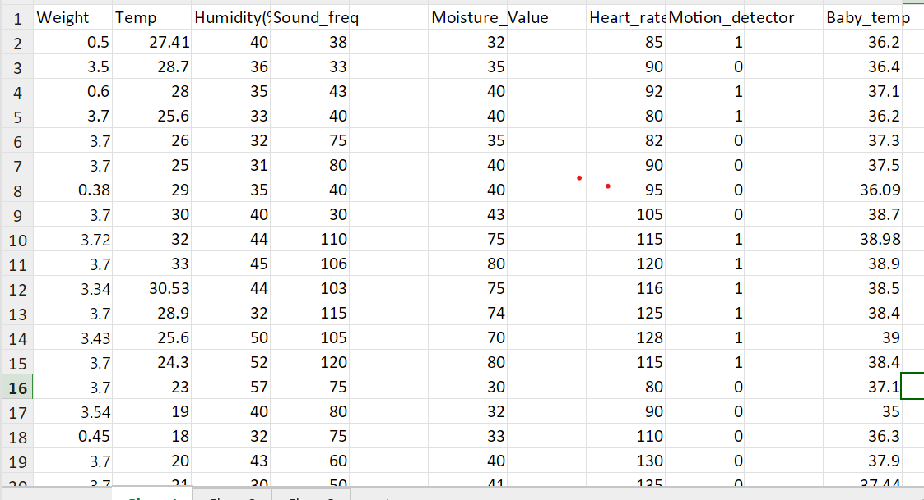
Input csv file

Slide 9
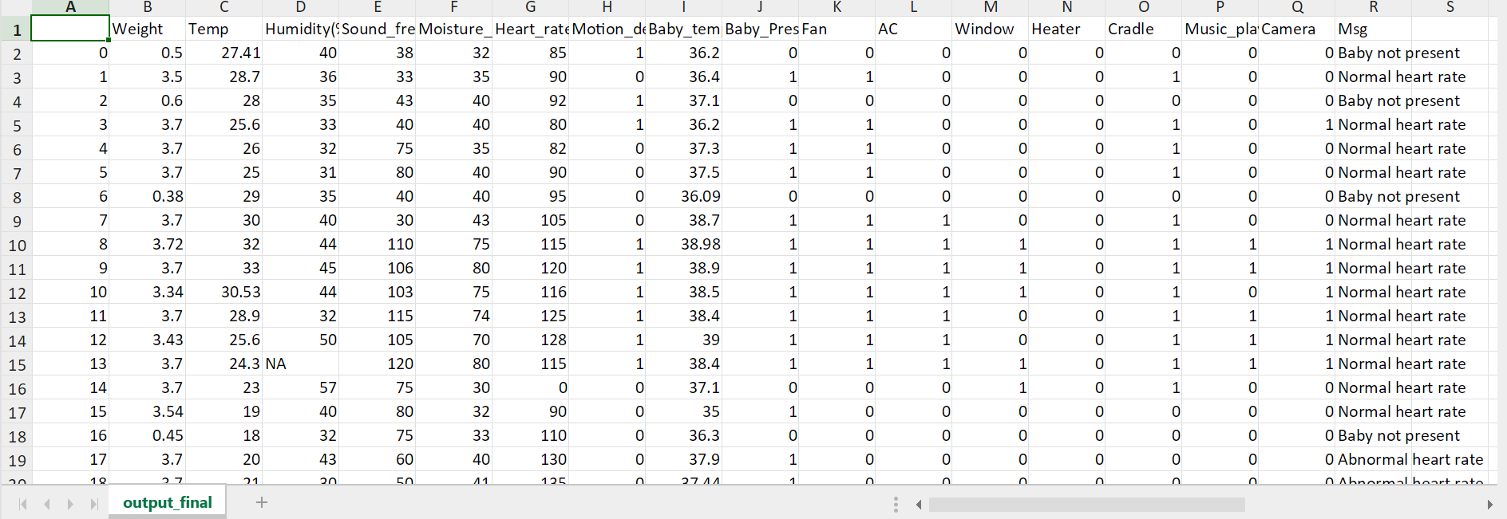
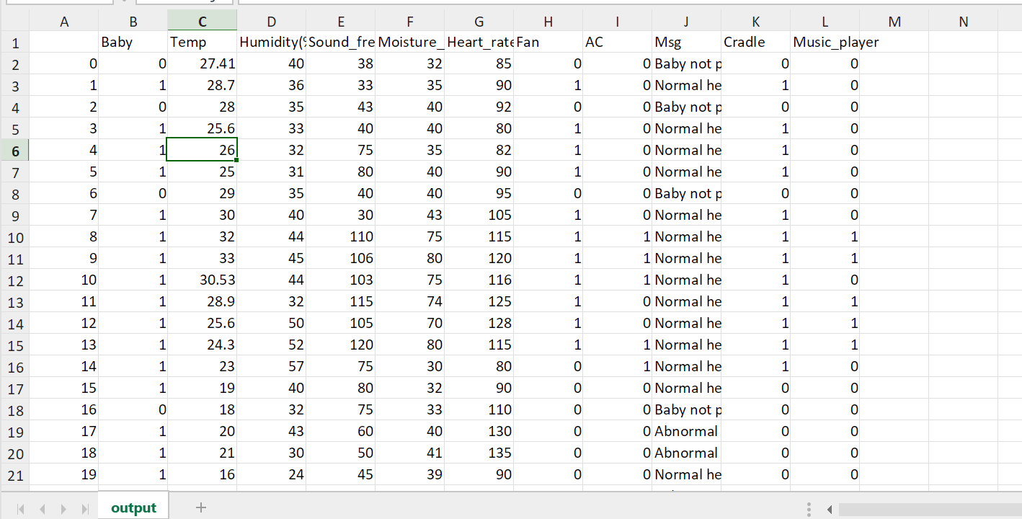
Output csv file

Slide 10
gOOGLE COLAB LINK
https://colab.research.google.com/drive/1NBLeTD_Vkmx00_cH7PBInZdcRGZMZKEG?usp=sharing

Slide 11
Baby care system part 2
Parents need to visually look into baby what she is doing all the time but it is quite difficlut task to keep an eye all the time.
So this module focuses on visual monitoring of baby.
So we will fix a camera on the top of baby to keep track of baby movements and make note of it .

Slide 12
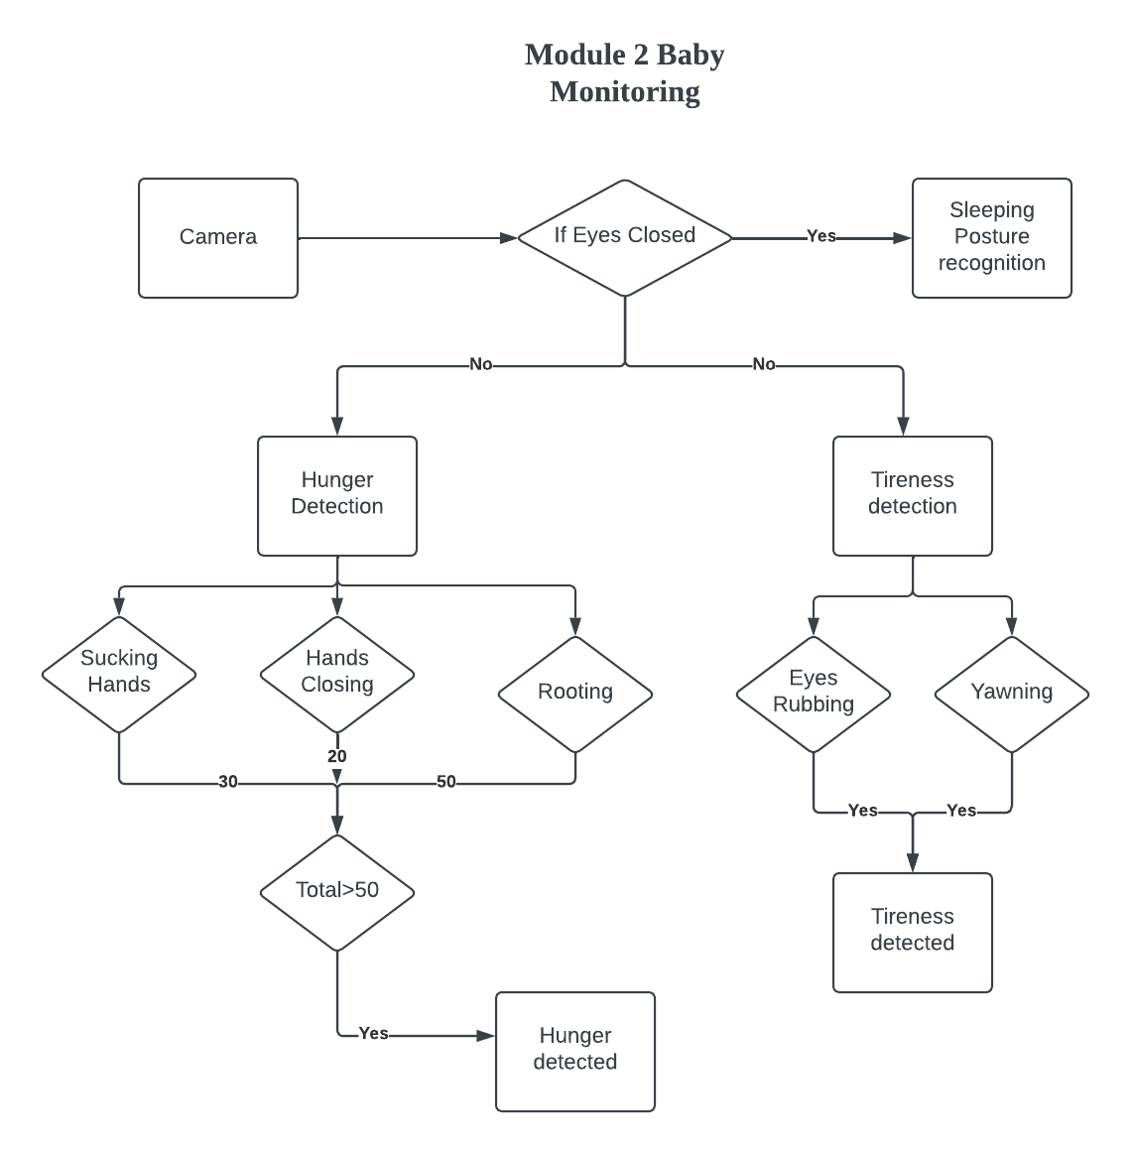
Proposed System diAgram for computer vision

Slide 13
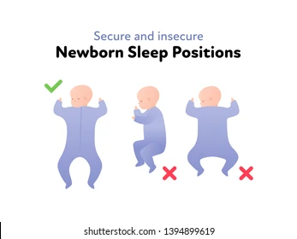
Determining sleeping posture
Babies tend to sleep in different postures according to their comforts but sometimes it lead to some consequences.
We need to make sure baby is sleeping in correct body position.

Slide 14
Sleep DETECTION
In this module we wil detect if baby is sleeping or not using Computer vision Open cv.
In computer vison there is a module called Mediapipe .In mediapioe we will get the cordinates of different parts of face.
We will get the cordinates of part of eye and lower part of eye. We will find the euclidian distance between 2 points and if the distance between them is 0 then system will determine that baby is sleeping.

Slide 15
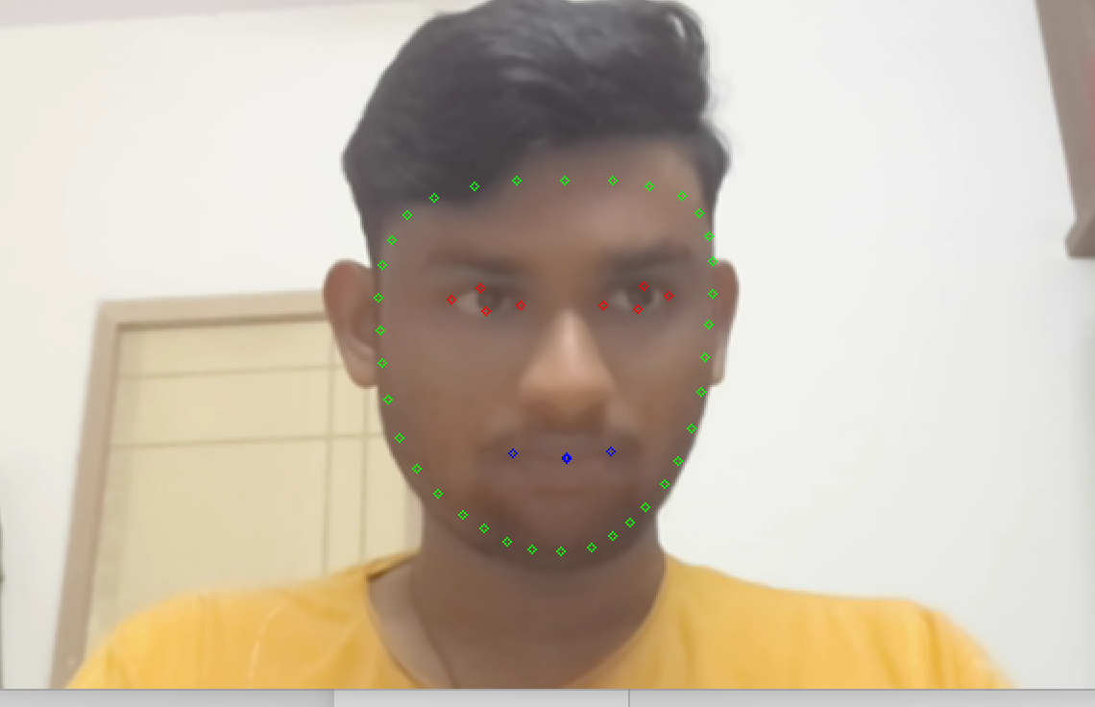
Face Mesh using mediapipe for sleep detection

Slide 16
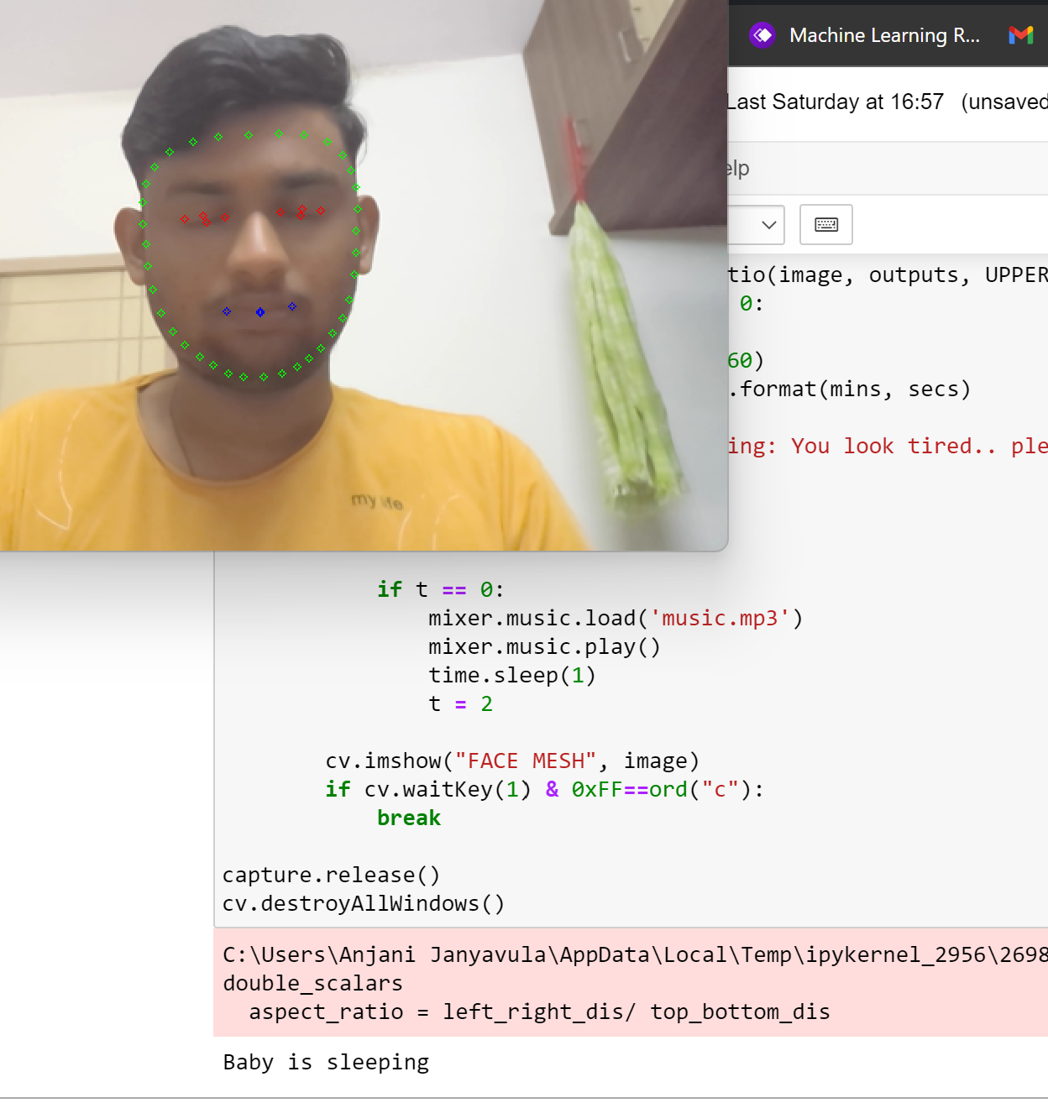
Output for closing of eyes for 4secs

Slide 17
SLEEPING POSTURE RECOGNITION
If the baby is sleeping then we need to find the sleeping posture.
It is said that baby should sleep in upright position so thatit is good for heart . So in this module we will determine sleeping posture.
In mediapipe we will also get the cordinates of left part of lip to right most part. if thd baby is sleeping upper side then lips will be clearly visible and distance between them is large. But when head psotion is moving toward the bed then distance will graduakly decrease and becomes 0 if the baby is sleeping backward. So,the system detects that and send a message to oarent to make sure baby sleeps in correct position.

Slide 18
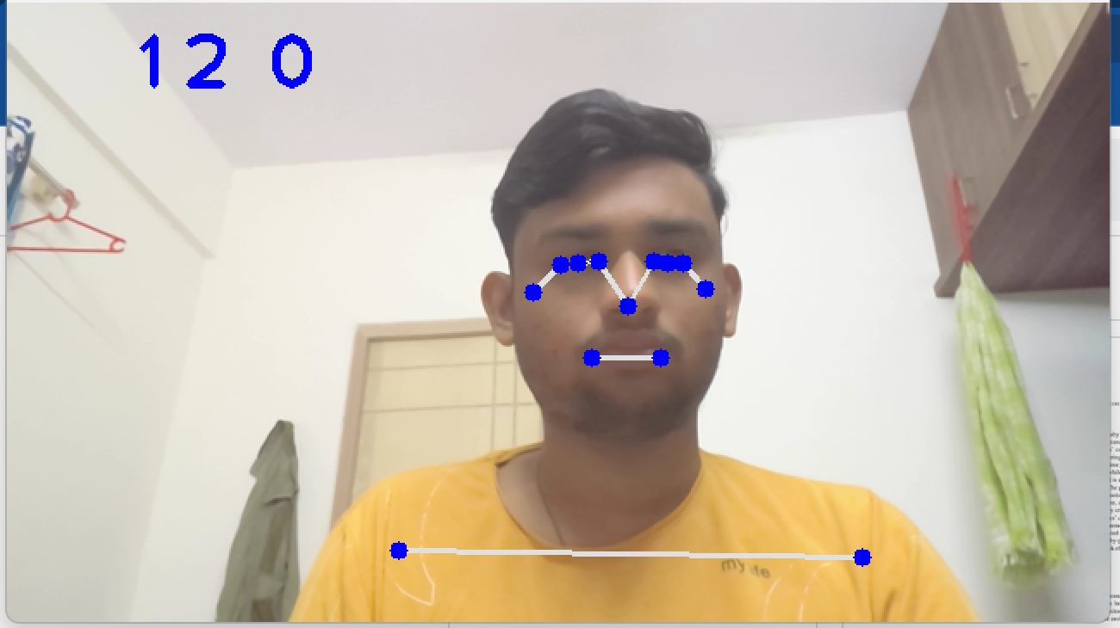
Face mesh for sleep position detection

Slide 19
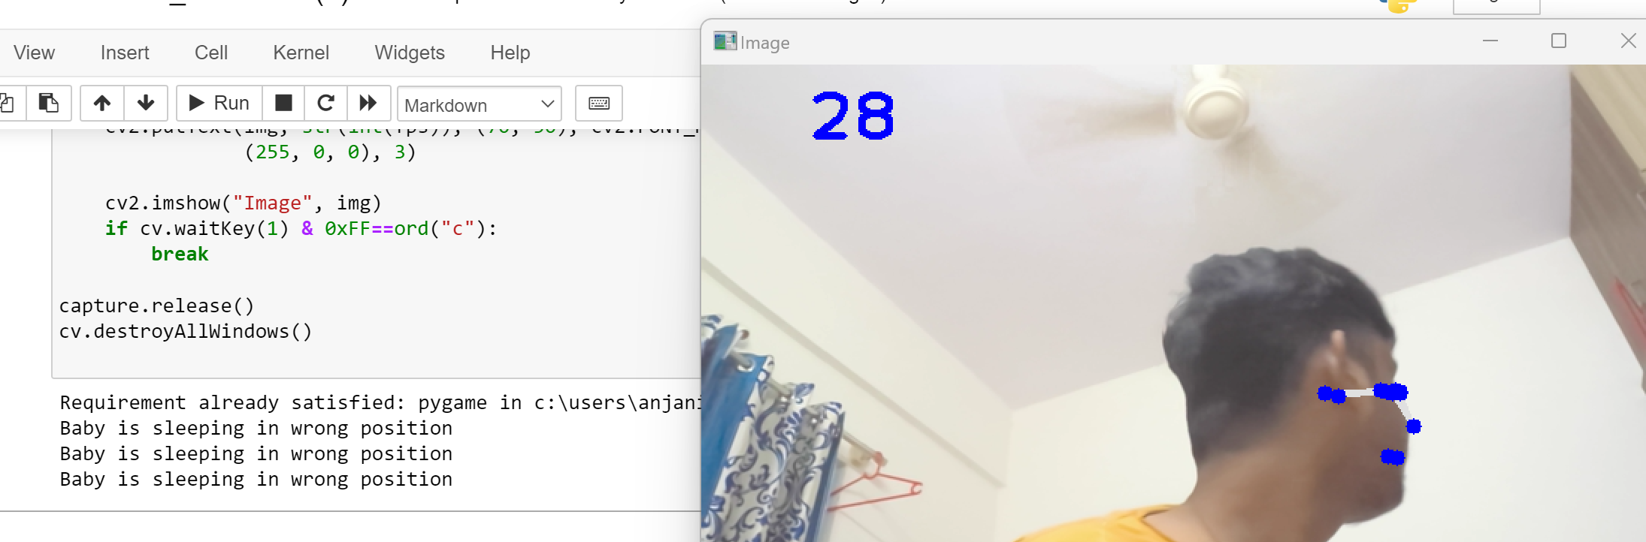
Output after wrong sleeping position detected

Slide 20
decoding babies body language
Babies are non expressive they cannot tell what they feel and what they want.However in some studies it is said that we can study what baby needs from their body language and movements.
So in this module we will decode what baby need .
Here are some resources regarding that
https://www.parents.com/baby/development/social/decode-your-babys-body-language/

Slide 21
HUNGER DETECTION
If the baby is not sleeping we need to monitor the movements of baby for cues.
In mediapipe there is a module called Pose estimation which will determine the poses of baby and keep track of movements.
We can determine if the baby is hungry or not by using cues published by different kinds of baby related sites.
After determing the cues we will send the message to parent.

Slide 22
hunger cues
Fist moving towards mouth.
Looking of mother.
sucking hands
Opening and cloding mouth.

Slide 23
Face mesh for hunger prediction

Slide 24
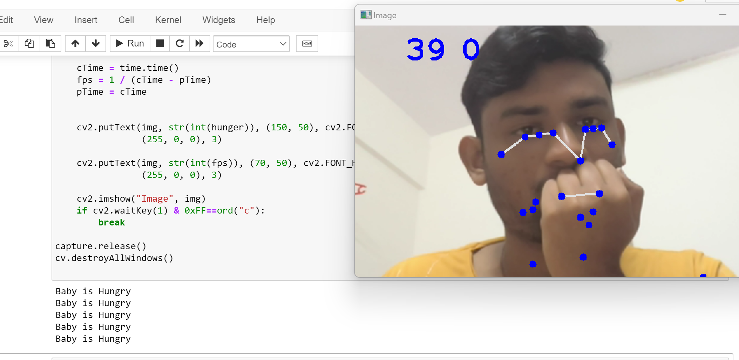
output for hunger detection

Slide 25
Detection of tiredness of baby
There are many cases baby may feel tired . So we need to make sure to keep baby engaging all the time.
In this module we will determine if the baby is feeling bored or tired by keeping in consideration of several cues from baby care center.
Cues of tiredness of baby
Pulling eyes and ear
Yawning
If the system determines that baby is tired then music player will switch on

Slide 26
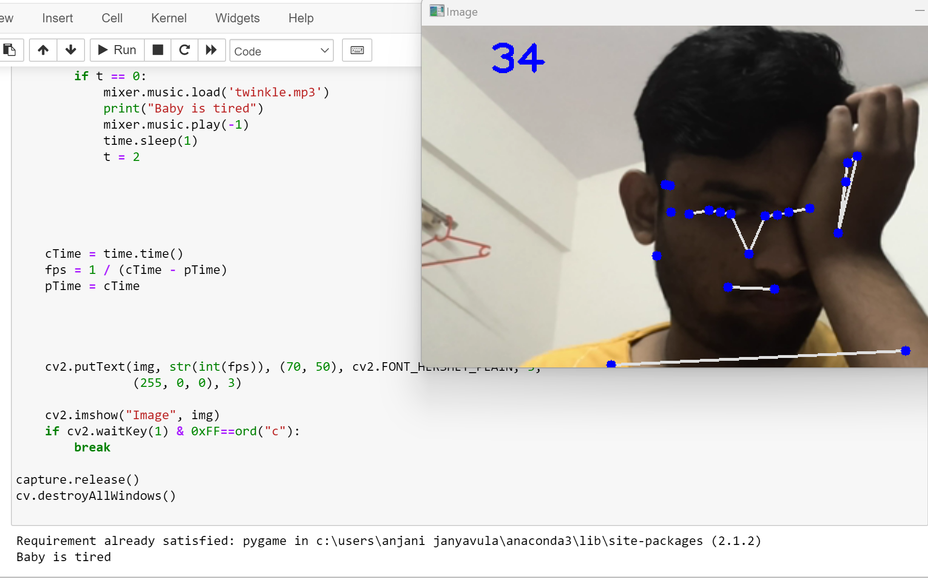
output for tiredness detection with music

Slide 27
Algorithm Of vision based baby care Module
Media-pipe framework will detect the eyes of baby and pper part of eye to find the distance between top part of eye to lower part of eye.
Hunger=0
If difference between eyelids==0 && time_delay>5sec:
Print(“Baby is sleeping”)
#If baby is sleeping we will detect the sleeping posture of baby
#Landmarks of baby body will be detected by Media-Pipe
If (Landmarks of eyes or nose present):
Baby is sleeping in right position
Else:
Baby is sleeping in wrong position

Slide 28
cont..
Else:
#If Baby is not sleeping hunger and tiredness is detected
If (Baby is Sucking Hands):
Hunger=Hunger+30
Elif(Baby is closing fists):
Hunger=Hunger+20
Elif(Baby is rooting for food):
Hunger=Hunger+50

Slide 29
If(Hunger>50):
Print(Baby is feeling Hungry”)
#Tiredness detection
If(Baby is yawning):
Print(“Baby is tired”)
If(Baby is rubbing eyes):
Print(“Baby Tireness detected)

Slide 30
REFERENCe
https://wicbreastfeeding.fns.usda.gov/babys-hunger-cues#:~:text=Signs%20Your%20Baby%20is%20Hungry&text=Fists%20moving%20to%20mouth.,on%20hands%20or%20lip%20smacking.
https://raisingchildren.net.au/babies/sleep/understanding-sleep/tired-signs#:~:text=Newborn%20tired%20signs%20include%20pulling,and%20not%20wanting%20to%20play.
https://www.lullabytrust.org.uk/safer-sleep-advice/sleeping-position/#:~:text=You%20should%20always%20place%20your,sleeping%20as%20safely%20as%20possible.
https://raisingchildren.net.au/newborns/connecting-communicating/communicating/baby-cues
https://raisingchildren.net.au/newborns/behaviour/understanding-behaviour/newborn-behaviour
https://google.github.io/mediapipe/getting_started/python.html

Slide 31
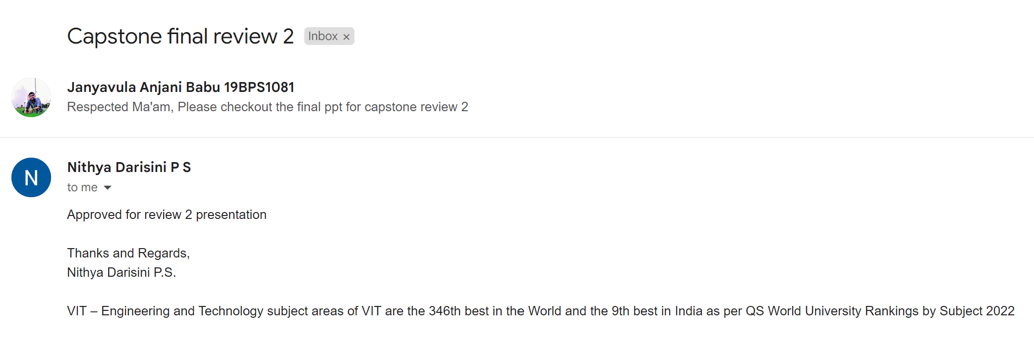
GUIDE APPROVAL

Slide 32
THANK YOU

